Slide 1
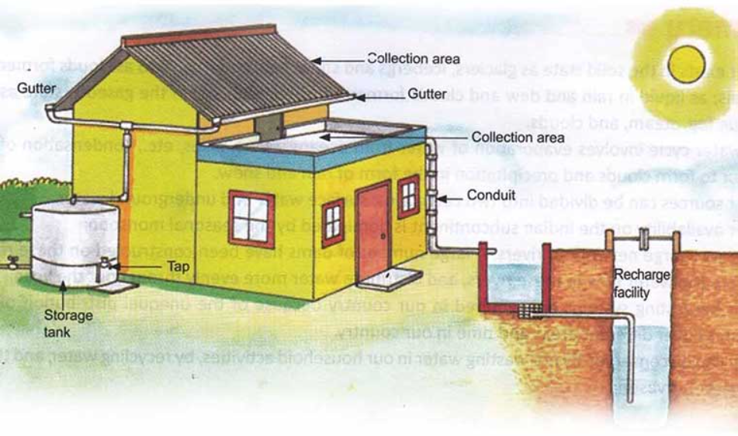
RAIN WATER HARVESTING
It is a system of catching rainwater where it falls. In rooftop harvesting, the roof becomes the catchment, and the rainwater is collected from the roof of the house/building.
k
It can either be stored in a tank or diverted to an artificial recharge system. This method is less expensive and very useful and, if implemented correctly, helps in adding to the groundwater level of the area. The essential components under which the rooftop harvesting can be practiced are shown in the figure.

Slide 2
The main sub components of rain water harvesting comprises of:
1. CATCHMENT: The surface where the rain assembles to be collected, this can be a part of any terrace or courtyard or even an open ground.
2. Transportation: The mode of transferring the collected rain water to harvesting tanks where it can be processed through water pipes which should be rigid and protected from any external cause.
3. First Flush: It is a device which is used to flush out the first shower of the rain before the water stored gets contaminated by contaminates present in the atmosphere.
4. Filter: Filters are used for the treatment of water by removing the contaminents and microrganisms present in it before passing it to storage after the first flush the water has to pass through the filter.

